Slide 1

TRAINING CONTENT
Kubernetes
Session-3
Image Placeholder

Slide 2
Lecture Outline
High Availability in Kubernetes
How does Kubernetes work
Pods in Kubernetes
Deployment
Pod vs deployment
Namespace
Service in Kubernetes
Service types in Kubernetes
Ingress

Slide 3
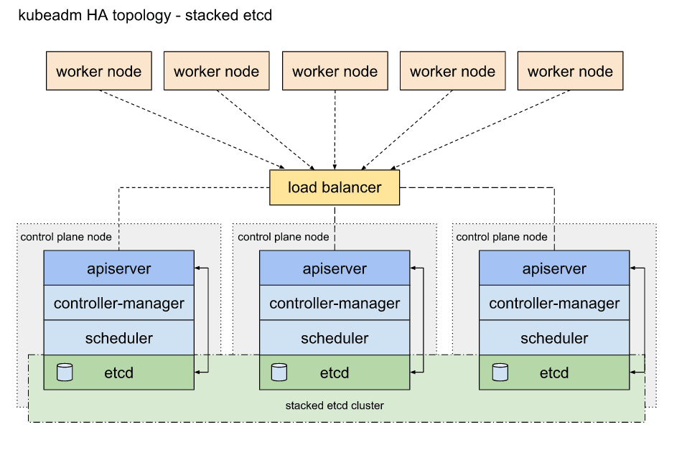
Lecture Outline
High availability in Kubernetes

Slide 4
Lecture Outline
How does Kubernetes work
Namespace – is isolated platform where application can be deployed
Atomic Unit (smallest) – pod which is logical boundary holds single container or multiple container.
Several Core components in master node deployed as static pod
Every Core components communicates with each other using TLS authentication
Many Kubernetes Objects like deployment, Service, Daemonsets, Statefulsets, persistent volume and so on.

Slide 5
Lecture Outline
Pods in Kubernetes
Smallest unit of k8s
Abstraction over container
Usually one application per pod
Can have multiple application in a single pod
Each pod gets it’s own IP address
Get’s new IP in each re-creation

Slide 6
Lecture Outline
Pod example yml

Slide 7
Lecture Outline
Deployments in Kubernetes
Deployment is actually the blueprint for pods
In practice we create deployments not pods
Abstraction of pod
Replica Set
Scaling
Rolling Updates
Rollbacks
Health Checks

Slide 8
Lecture Outline
Deployments example

Slide 9
Lecture Outline
Pod vs Deployment
Pod
Deployment
Pod is the smallest and most basic unit in Kubernetes.
represents a single instance of a running process within the cluster.
Pod can contain one or more tightly coupled containers that share the same resources, such as network namespace and storage volumes.
Pods are usually ephemeral and are not designed for direct management or scaling.
Pods are typically used for running a single instance of an application or for running helper containers.
Deployment is a higher-level resource that manages the lifecycle and scaling of multiple identical Pods.
Deployments ensure the desired number of Pod replicas are running and handle scaling, rolling updates, and rollbacks.
Deployments use a ReplicaSet under the hood to maintain the desired state and ensure availability.
Deployments are commonly used to achieve fault tolerance, high availability, and manage application updates seamlessly.

Slide 10
Lecture Outline
Namespace in Kubernetes
Kubectl create namespace test-namespace
A logical partition within a Kubernetes cluster
provides a way to divide cluster resources among multiple users, teams, or projects
Namespaces are primarily used to create separate environments for different applications
isolate resources and prevent conflicts between them
Key features
Isolation
Resource quota
Network isolation
Object scope
Access control

Slide 11
Lecture Outline
Service in Kubernetes
Permanent IP address
Lifecycle of pods and service not connected
Pods communicate with each other using service
You have to specify service type while service creation

Slide 12
Lecture Outline
Service example

Slide 13
Lecture Outline
Service Types in Kubernetes
External service
Internal service
If you want to access you application from browser you have to create an external service
If you don’t want to expose you application publicly create internal service like DB
Internal service
External service
Cluster IP service
Headless service
Node port service
Load Balancer service
Ingress service

Slide 14
Lecture Outline
Ingress in Kubernetes
HTTP/HTTPS based traffic
Custom Domain
URL Based routing
Path Based routing
TLS termination
Load Balancing

Slide 15
Thank You
Image Placeholder

